Slide 1
DTS205TC High Performance Computing
Lecture 7 Methodology 2
Di Zhang, Spring 2024

Slide 2
Mapping Techniques
Once a problem has been decomposed into concurrent tasks, these must be mapped to processes (that can be executed on a parallel platform).
Mappings must minimize overheads.
Primary overheads are communication and idling.
Minimizing these overheads often represents contradicting objectives.
Assigning all work to one processor trivially minimizes communication at the expense of significant idling.

Slide 3
Mapping Techniques for Minimum Idling
Mapping must simultaneously minimize idling and load balance. Merely balancing load does not minimize idling.

Slide 4
Mapping Techniques for Minimum Idling
Mapping techniques can be static or dynamic.
Static Mapping: Tasks are mapped to processes a-priori. For this to work, we must have a good estimate of the size of each task. Even in these cases, the problem may be NP complete.
Dynamic Mapping: Tasks are mapped to processes at runtime. This may be because the tasks are generated at runtime, or that their sizes are not known.
Other factors that determine the choice of techniques include the
size of data associated with a task and the nature of underlying
domain.

Slide 5
Schemes for Static Mapping
Mappings based on data partitioning.
Mappings based on task graph partitioning.
Hybrid mappings.

Slide 6
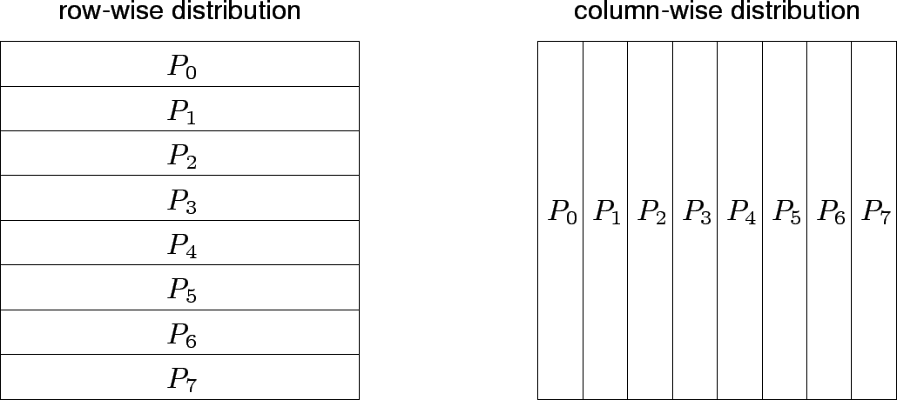
Mappings Based on Data Partitioning
We can combine data partitioning with the ``owner-computes'' rule to partition the computation into subtasks. The simplest data decomposition schemes for dense matrices are 1-D block distribution schemes.

Slide 7
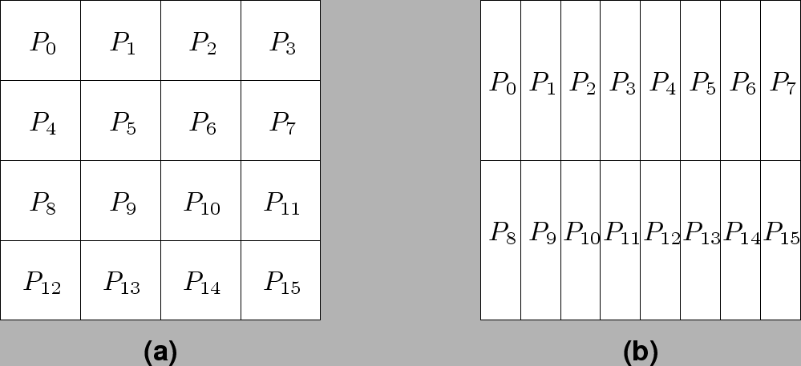
Block Array Distribution Schemes
Block distribution schemes can be generalized to higher dimensions as well.

Slide 8
Block Array Distribution Schemes: Examples
For multiplying two dense matrices A and B, we can partition the output matrix C using a block decomposition.
For load balance, we give each task the same number of elements of C. (Note that each element of C corresponds to a single dot product.)
The choice of precise decomposition (1-D or 2-D) is determined by the associated communication overhead.
In general, higher dimension decomposition allows the use of larger number of processes.

Slide 9
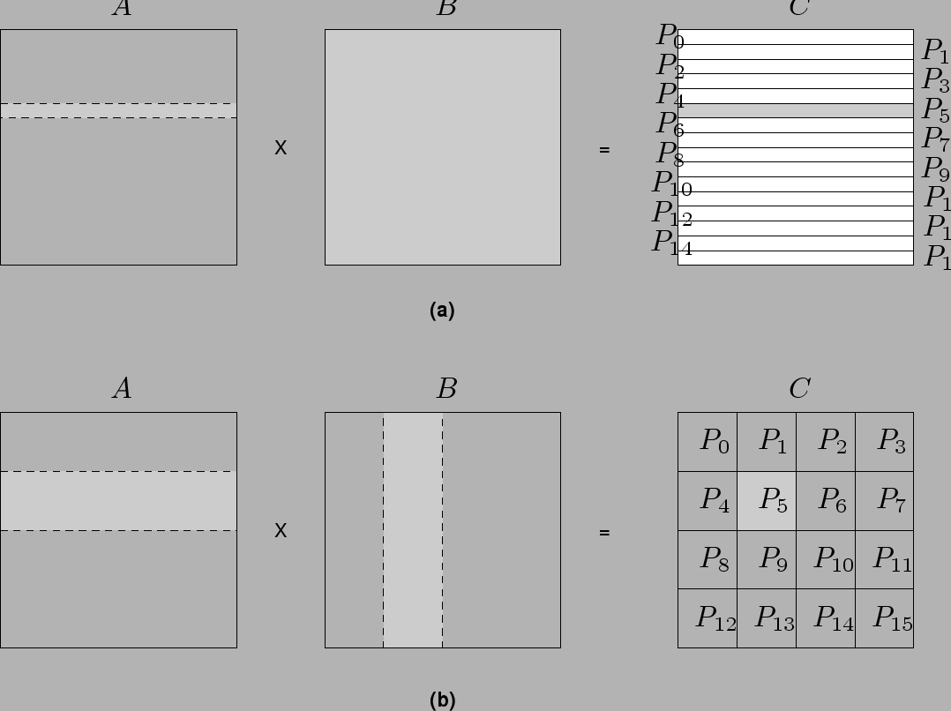
Data Sharing in Dense Matrix Multiplication

Slide 10
Cyclic and Block Cyclic Distributions
If the amount of computation associated with data items varies, a block decomposition may lead to significant load imbalances.
A simple example of this is in LU decomposition (or Gaussian Elimination) of dense matrices.

Slide 11
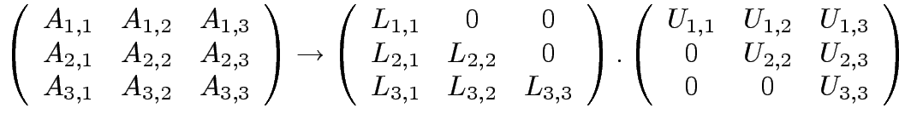














LU Factorization of a Dense Matrix
A decomposition of LU factorization into 14 tasks - notice the
significant load imbalance.
1: 2: 3: 4: 5: | 6: 7: 8: 9: 10: | 11: 12: 13: 14:

Slide 12
Block Cyclic Distributions
Variation of the block distribution scheme that can be used to alleviate the load-imbalance and idling problems.
Partition an array into many more blocks than the number of available processes.
Blocks are assigned to processes in a round-robin manner so that each process gets several non-adjacent blocks.

Slide 13
Block-Cyclic Distribution for Gaussian Elimination
The active part of the matrix in Gaussian Elimination changes. By assigning blocks in a block-cyclic fashion, each processor receives blocks from different parts of the matrix.

Slide 14
Block-Cyclic Distribution: Examples
One- and two-dimensional block-cyclic distributions among 4 processes.

Slide 15
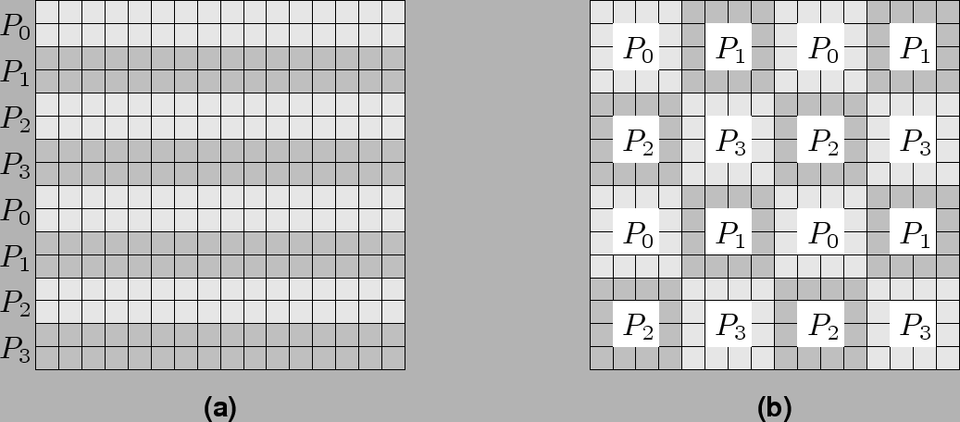
Block-Cyclic Distribution
A cyclic distribution is a special case in which block size is one.
A block distribution is a special case in which block size is n/p , where n is the dimension of the matrix and p is the number of processes.

Slide 16
Graph Partitioning Dased Data Decomposition
In case of sparse matrices, block decompositions are more complex.
Consider the problem of multiplying a sparse matrix with a vector.
The graph of the matrix is a useful indicator of the work (number of nodes) and communication (the degree of each node).
In this case, we would like to partition the graph so as to assign equal number of nodes to each process, while minimizing edge count of the graph partition.

Slide 17
Partitioning the Graph of Lake Superior
Random Partitioning
Partitioning for minimum edge-cut.

Slide 18
Mappings Based on Task Paritioning
Partitioning a given task-dependency graph across processes.
Determining an optimal mapping for a general task-dependency graph is an NP-complete problem.
Excellent heuristics exist for structured graphs.

Slide 19
Task Paritioning: Mapping a Binary Tree Dependency Graph
Example illustrates the dependency graph of one view of quick-sort
and how it can be assigned to processes in a hypercube.

Slide 20
Task Paritioning: Mapping a Sparse Graph
Sparse graph for computing a sparse matrix-vector product and its mapping.

Slide 21
Hierarchical Mappings
Sometimes a single mapping technique is inadequate.
For example, the task mapping of the binary tree (quicksort) cannot use a large number of processors.
For this reason, task mapping can be used at the top level and data partitioning within each level.

Slide 22
An example of task partitioning at top level with data partitioning at the lower level.

Slide 23
Schemes for Dynamic Mapping
Dynamic mapping is sometimes also referred to as dynamic load balancing, since load balancing is the primary motivation for dynamic mapping.
Dynamic mapping schemes can be centralized or distributed.

Slide 24
Centralized Dynamic Mapping
Processes are designated as masters or slaves.
When a process runs out of work, it requests the master for more work.
When the number of processes increases, the master may become the bottleneck.
To alleviate this, a process may pick up a number of tasks (a chunk) at one time. This is called Chunk scheduling.
Selecting large chunk sizes may lead to significant load imbalances as well.
A number of schemes have been used to gradually decrease chunk size as the computation progresses.

Slide 25
Distributed Dynamic Mapping
Each process can send or receive work from other processes.
This alleviates the bottleneck in centralized schemes.
There are four critical questions: how are sensing and receiving processes paired together, who initiates work transfer, how much work is transferred, and when is a transfer triggered?
Answers to these questions are generally application specific. We will look at some of these techniques later in this class.

Slide 26
Minimizing Interaction Overheads
Maximize data locality: Where possible, reuse intermediate data. Restructure computation so that data can be reused in smaller time windows.
Minimize volume of data exchange: There is a cost associated with each word that is communicated. For this reason, we must minimize the volume of data communicated.
Minimize frequency of interactions: There is a startup cost associated with each interaction. Therefore, try to merge multiple interactions to one, where possible.
Minimize contention and hot-spots: Use decentralized techniques, replicate data where necessary.

Slide 27
Minimizing Interaction Overheads (continued)
Overlapping computations with interactions: Use non-blocking communications, multithreading, and prefetching to hide latencies.
Replicating data or computations.
Using group communications instead of point-to-point primitives.
Overlap interactions with other interactions.

Slide 28
Parallel Algorithm Models
An algorithm model is a way of structuring a parallel algorithm by selecting a decomposition and mapping technique and applying the appropriate strategy to minimize interactions.
Data Parallel Model: Tasks are statically (or semi-statically) mapped to processes and each task performs similar operations on different data.
Task Graph Model: Starting from a task dependency graph, the interrelationships among the tasks are utilized to promote locality or to reduce interaction costs.

Slide 29
Parallel Algorithm Models (continued)
Master-Slave Model: One or more processes generate work and allocate it to worker processes. This allocation may be static or dynamic.
Pipeline / Producer-Comsumer Model: A stream of data is passed through a succession of processes, each of which perform some task on it.
Hybrid Models: A hybrid model may be composed either of multiple models applied hierarchically or multiple models applied sequentially to different phases of a parallel algorithm.

Slide 30
Gallery of patterns and models
Decomposition Patterns
  Data (DD)
  Recursive (RD)
  *Exploratory
  *Speculative
  *Hybrid
Mapping Patterns
  Static
    Block distribution (BD)
    *Others
  Dynamic
    Centralized Scheme (CS)
      Worker pool (WP)
      Master-slave (MS)
    *Distributed Scheme
Models
  Embarrassingly parallel
  = DD + BD/CS
  Fork–join
  = RD + BD/CS
  *Pipeline
  Geometric
  = DD + BD
  * Will not be discussed in this course
Notes:
There are many complex patterns here, marked with asterisks

Slide 31
Embarrassingly parallel
There is little or no dependency or need for communication between its parallel tasks.
Example:
  Monte Carlo sampling
  Relational database queries
  Brute force search, grid search
  Predict many instance by one model
  Random forest

Slide 32

Data parallelism
Any function to apply
Data parallelism refers to scenarios in which the same operation is performed concurrently (that is, in parallel) on elements in a source collection or array.
In data parallel operations, the source collection is partitioned so that multiple threads can operate on different segments concurrently.

Slide 33

Master-slave Model
Master
There are 1 master and K slaves
Master splits the data into K portions, and assigns them to K slaves
  This can also be the input parameter of processing function
After the calculation is completed, the result is returned to the master for the reduce operation

Slide 34
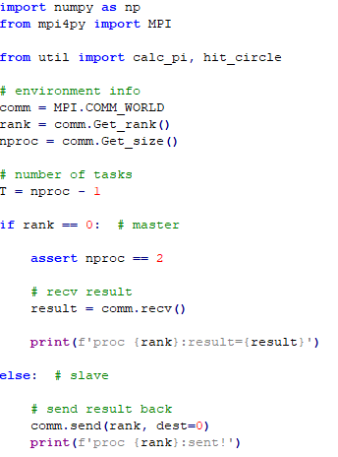
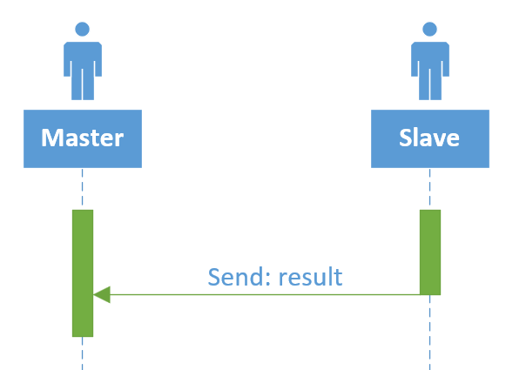
Interactive diagram and code
Please extend the program to more processes (task1)

Slide 35
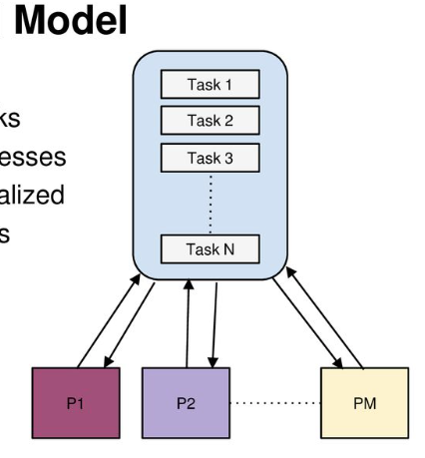
Workpool Model
There are 1 manager and M worker
Workers fetch their own task from a task pool. It must determine by itself whether there are still tasks and update the status of the tasks it has processed.
After the calculation is completed, it is returned to the manager for the reduce operation

Slide 36
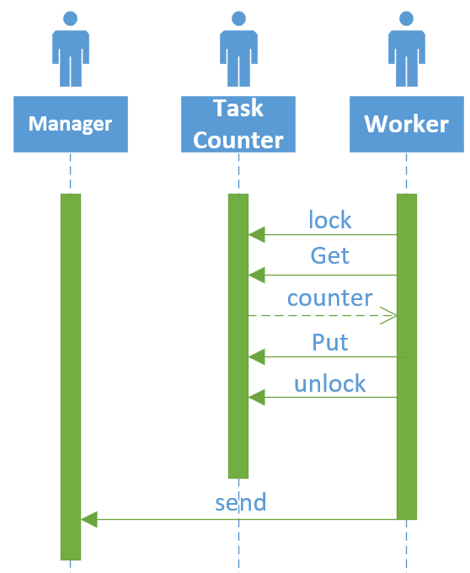
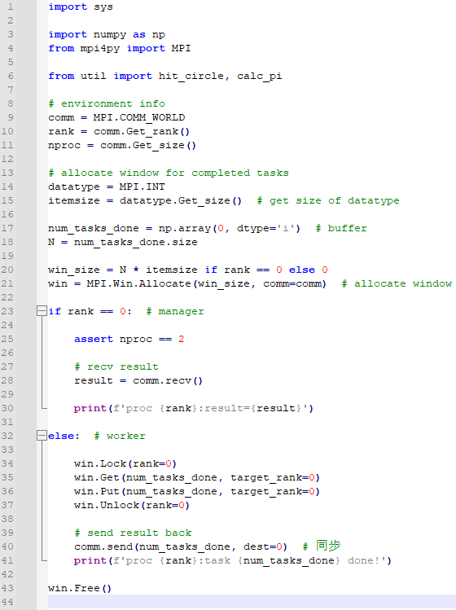
Interactive diagram and code
？
Please extend the program to more processes and add logic of judging whether all tasks are completed (task3)
Explain later…

Slide 37
Section
MPI One-side Communication

Slide 38
One-Sided Communications
One-sided communications
  Allows the communication process to be invisible to one of the parties, that is, it’s ok to write related code on one side
Advantage:
  Simplified procedures, just like shared storage, can be read and written directly, eliminating the need to transfer data back and forth
  Leverage underlying hardware support, if available
Notes
  It is necessary to be mutually exclusive, especially write. Thus, you need to set a lock.

Slide 39
Main steps
Create a window
  The window length here can only be calculated in bytes, so the size of the data structure must be estimated
The key data structure (num_tasks_done) here is stored in the rank=0 process, so it only needs to be allocated in this process; But other processes also declare the window, with the size set to 0

Slide 40
Main steps
Get exclusive access
  only the origin process calls the Win.Lock and Win.Unlock methods. Locks are used to protect remote accesses to the locked remote window and to protect local load/store accesses to a locked local window.

Slide 41
Main steps
Remote write, read and reduction are available through calling the methods Win.Put, Win.Get, and Win.Accumulate respectively within a Win instance.
These methods need an integer rank identifying the target process and an integer offset relative the base address of the remote memory block being accessed.
Note: After calling Win.Pet, the num_tasks_done will not be updated immediately! The num_tasks_done will be updated only after Win.Unlock is called.

Slide 42
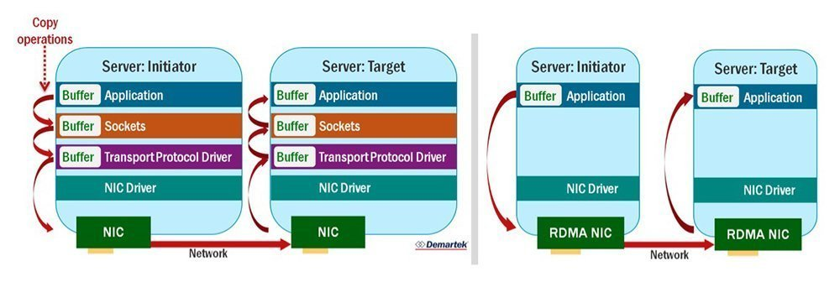
*Hardware support
Bypasses network protocol-related computation
The burden on the CPU is lightened because the network card takes over the transfer process

